Slide 1
Chapter 2: Fundamental Database Concepts

Slide 2
Learning outcomes
discuss the key features of databases and the rationale for using them;
contrast the characteristics and limitations of the relational database model and the graph database model, the two most important database paradigms;
develop a database design using entity-relationship modeling and the standard diagrammatic language UML;
build simple queries to a relational or graph database using a standard language, such as SQL or Cypher.

Slide 3
Section 2.1
Introduction to databases

Slide 4
What is a database?
A database is a collection of data organized in such a way that a computer can efficiently store and retrieve data
A repository of data that is logically related
A database is created and maintained using a general-purpose piece of software called a database management system (DBMS)

Slide 5
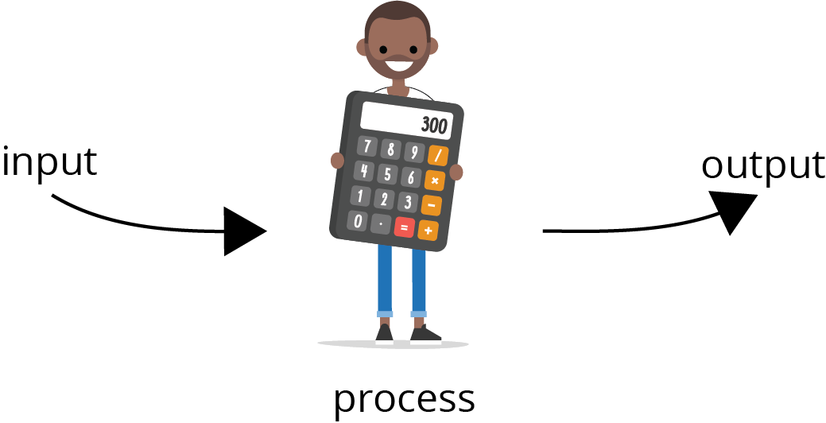
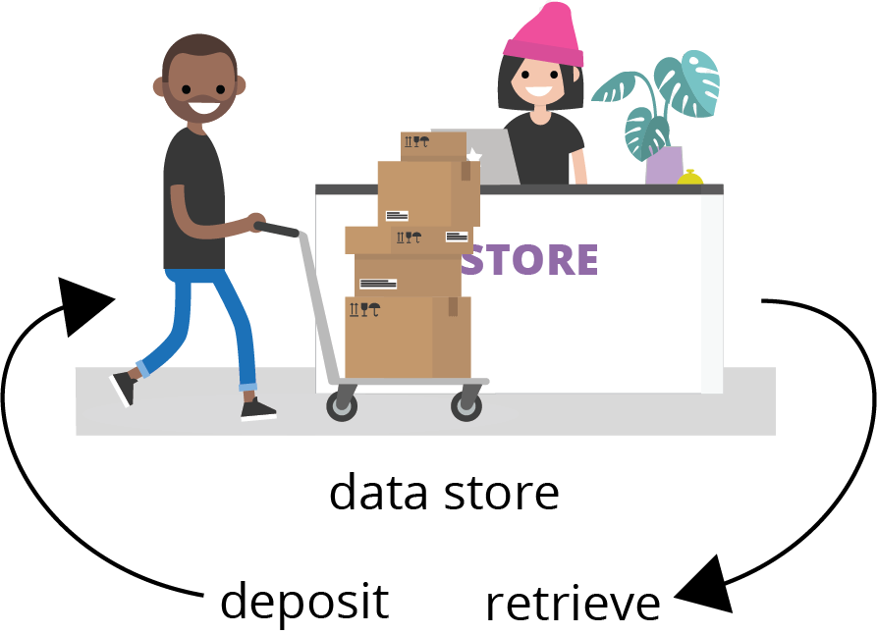
The database approach
Before databases, computers were primarily used to convert data between different formats
“The computer as a giant calculator”
Databases treat computers as useful repositories of data
“The computer as data repository”
Most applications (including GIS) require a balance of processing and storage

Slide 6
Databases in a nutshell
In order to be effective, databases must offer the following functions:
Reliability
Integrity
Security
User views
User interface
Data independence
Self-describing
Concurrency
Distributed capabilities
High performance
All these functions are managed by the DBMS

Slide 7
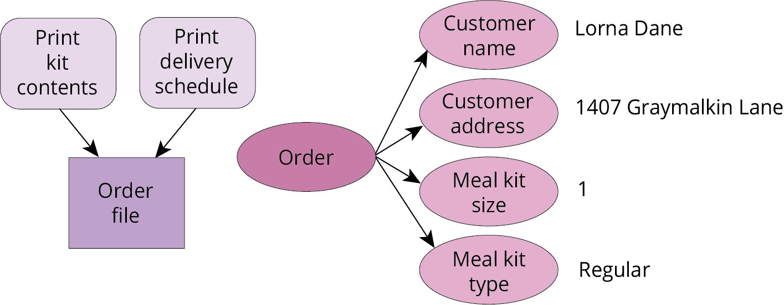
Nutty Nuggets #1
We might write a program to organize the stock for the “Nutty Nuggets” dinner kit company

Slide 8
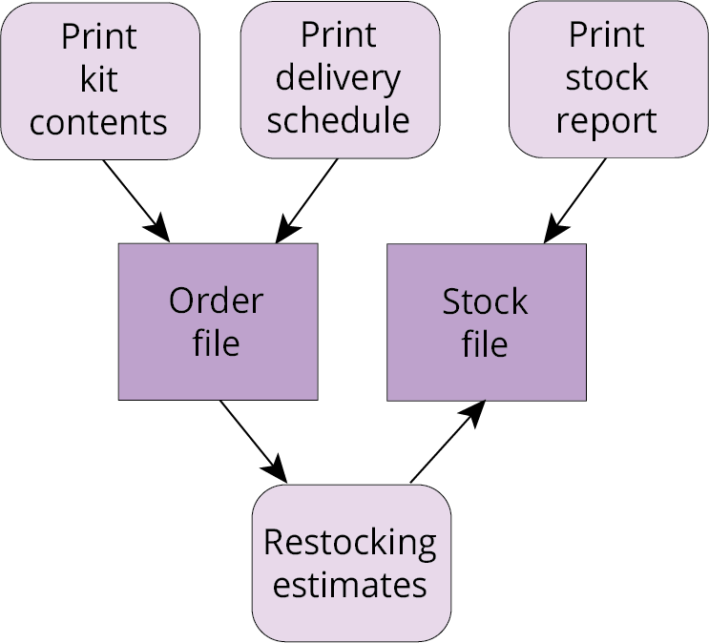
Nutty Nuggets #2
As time continues, this program will become more complex, offering more functions

Slide 9
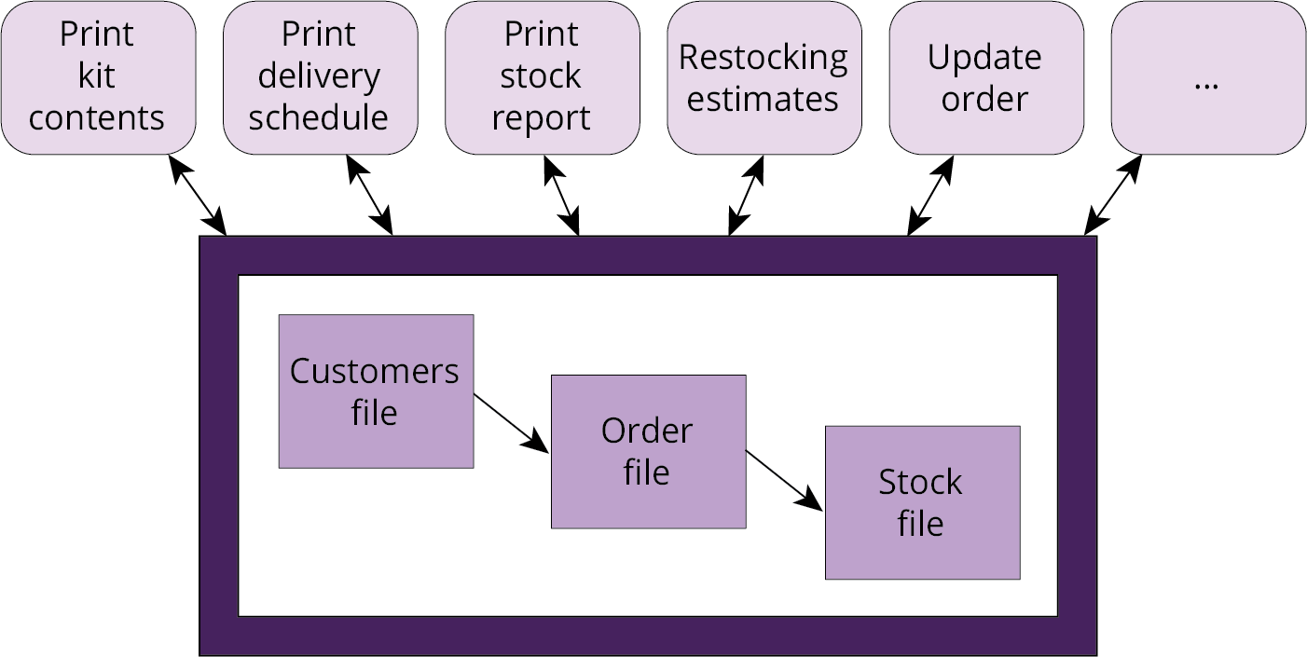
Nutty Nuggets #3
Key problems with the previous approach are:
Loss of integrity
Loss of independence
Loss of security
Stage 3, the database, solves these problems

Slide 10
Common database applications
Home/office database: small and inexpensive, and they may not require concurrent multi user access.
Enterprise database: widely used to manage the information of businesses, including financial and personnel data, enterprise databases must be secure and reliable, run on many platforms, offer high performance, and allow concurrent access by different groups of users.
Document store: enables storage and retrieval of a wide range of documents, such as web pages, catalogs, and social media and user-generated content.
Image database: allow the storage and retrieval of a wide range of media data types, such as images, audio, and video.
Geodatabase: stores a combination of spatial and non-spatial data and requires complex data structures and analyses.

Slide 11
Transaction management
A transaction is the most basic unit of interaction between a user and a database. Transactions primarily involve one or more of the following operations:
creation of data in the database,
retrieval of data from the database,
update of data in the database, or
deletion of data from the database.
Data stored in such a way that it continues to exist beyond the session in which it was created is said to be persistent.
Together, the four basic operations (creation, retrieval, update, and deletion) on persistent, stored data above are referred to as CRUD.

Slide 12
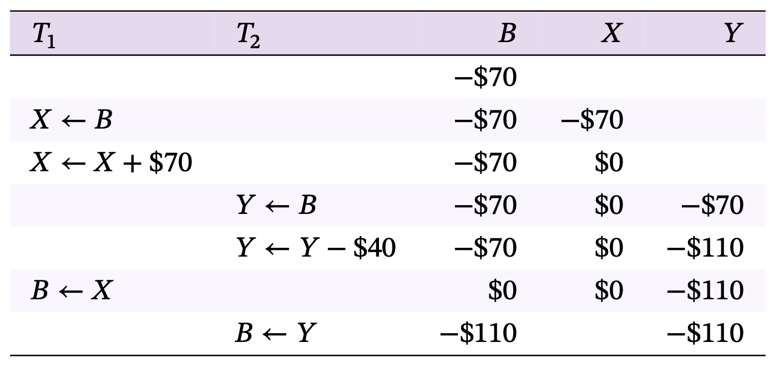
Concurrency and lost update
Lost update can occur when concurrent, atomic transactions are incorrectly interleaved

Slide 13
ACID properties
To prevent lost updates and other problems that can occur with concurrent transactions, any DBMS must be able to guarantee four ACID properties:
Atomicity: dictates that constituent operations of a transaction must either all have their effect on the database or else make no change to the database.
Consistency: ensures that all transactions may only result in valid database states compliant with all the database constraints.
Isolation: requires that concurrent transactions must leave the database in the same state as if the transactions were executed sequentially.
Durability: necessitates that transaction outcomes are persistent, even in the case of a serious system failure or power outage.

Slide 14
Section 2.2
Database design

Slide 15
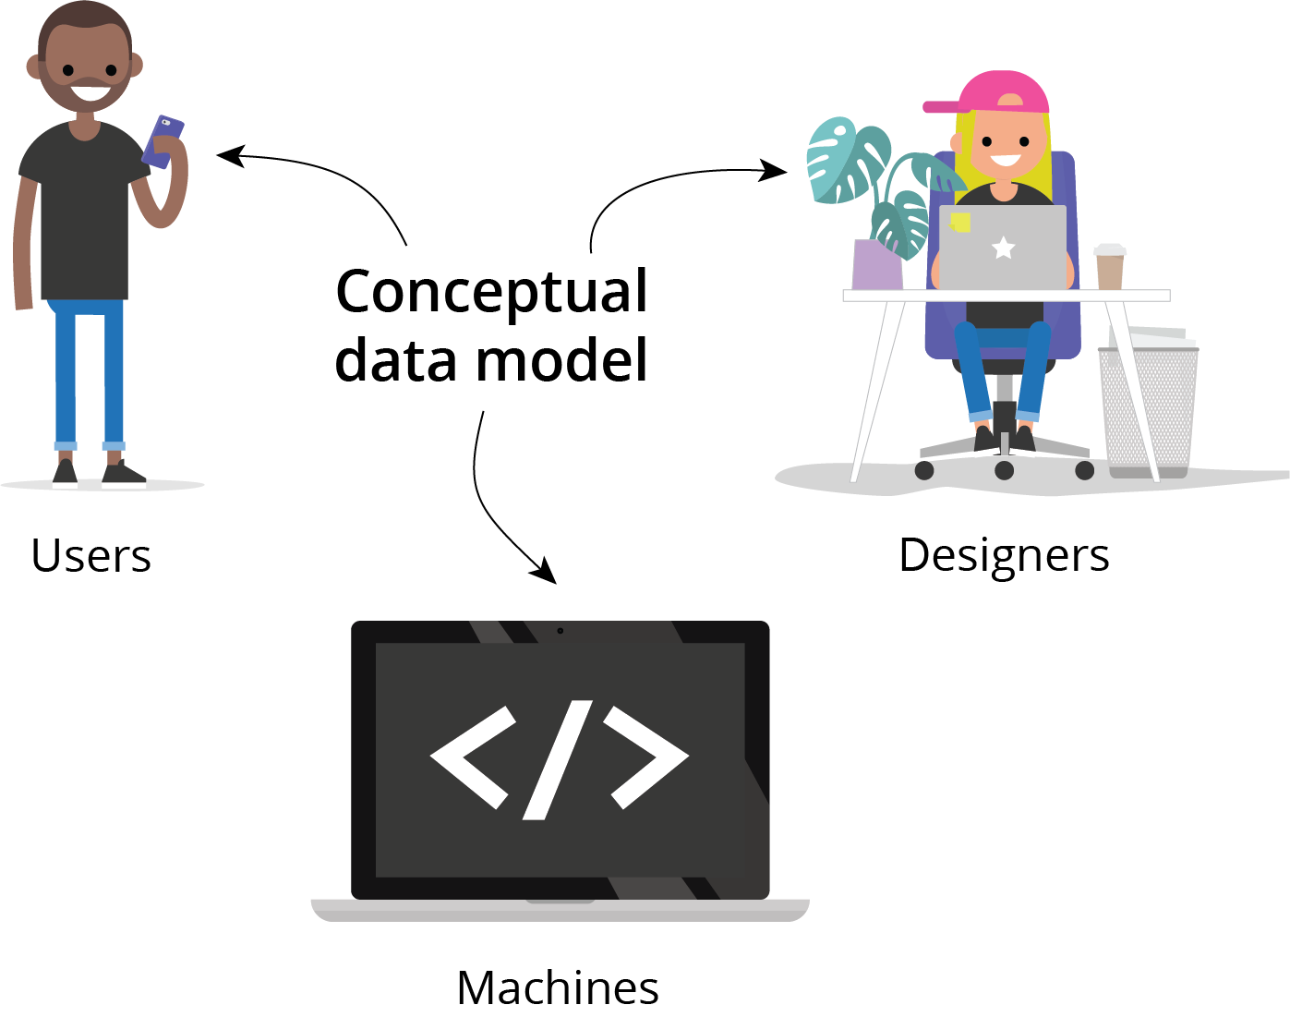
Conceptual data model
A conceptual data model provides a model of the proposed system that is independent of implementation details
An effective conceptual model will
provide a means for communication between analysts, designers and users
aid the design of the system
provide basic reference material for implemented system

Slide 16
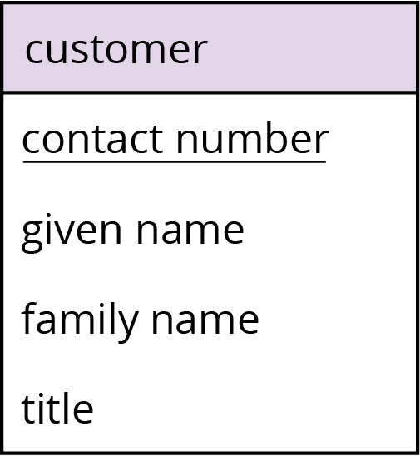
Entity relationship model #1
The entity relationship model is a conceptual data modeling technique where
An entity type represents a collection of similar objects
An entity instance is an occurrence of a particular entity
An attribute type is a property associated with an entity
An attribute type that serves to uniquely identify an entity type is called an identifier
Identifiers are usually underlined

Slide 17
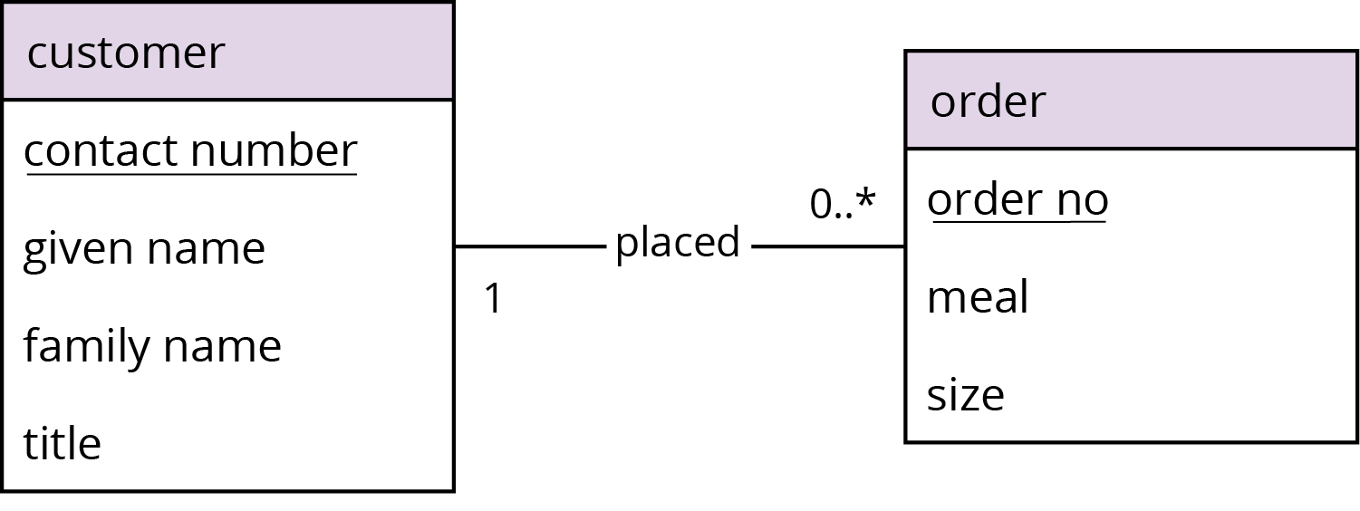
Entity relationship model #2
Entity types are connected using relationships
A relationship type connects one or more entity types
A relationship occurrence is a particular instance of a relationship
Relationships may have their own attributes independent of entities
Entity, attribute, and relationship types are shown in an entity relationship diagram (E-R diagram)

Slide 18
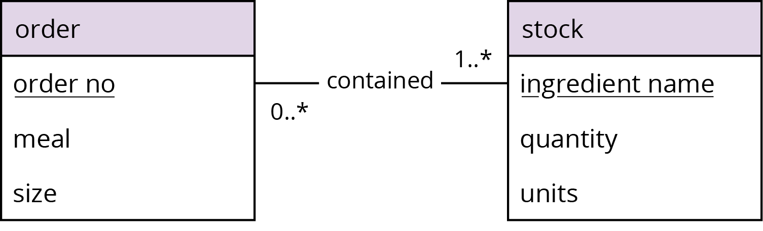
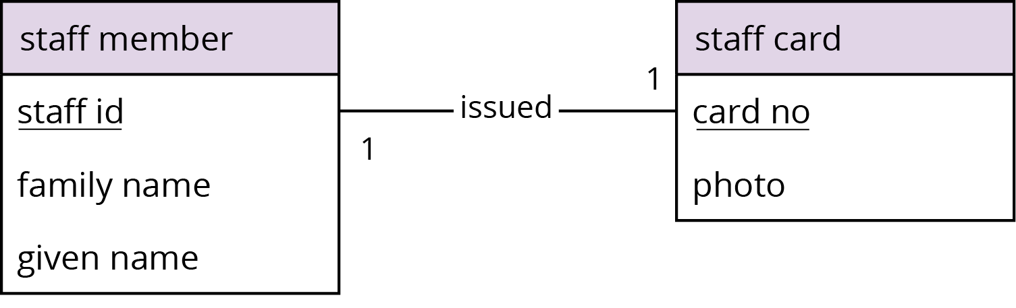
Entity relationship model #3
Relationship types may be
many-to-one: e.g., each customer may place several (potentially zero, one, or many) orders, but each order must be placed by exactly one customer
many-to-many: e.g., each stock item may appear in many different orders, and an order will naturally contain many different stock items
one-to-one: e.g., each staff member must have been issued a staff card, and each staff card is issued to that specific staff member
These constraints constitute cardinality conditions

Slide 19
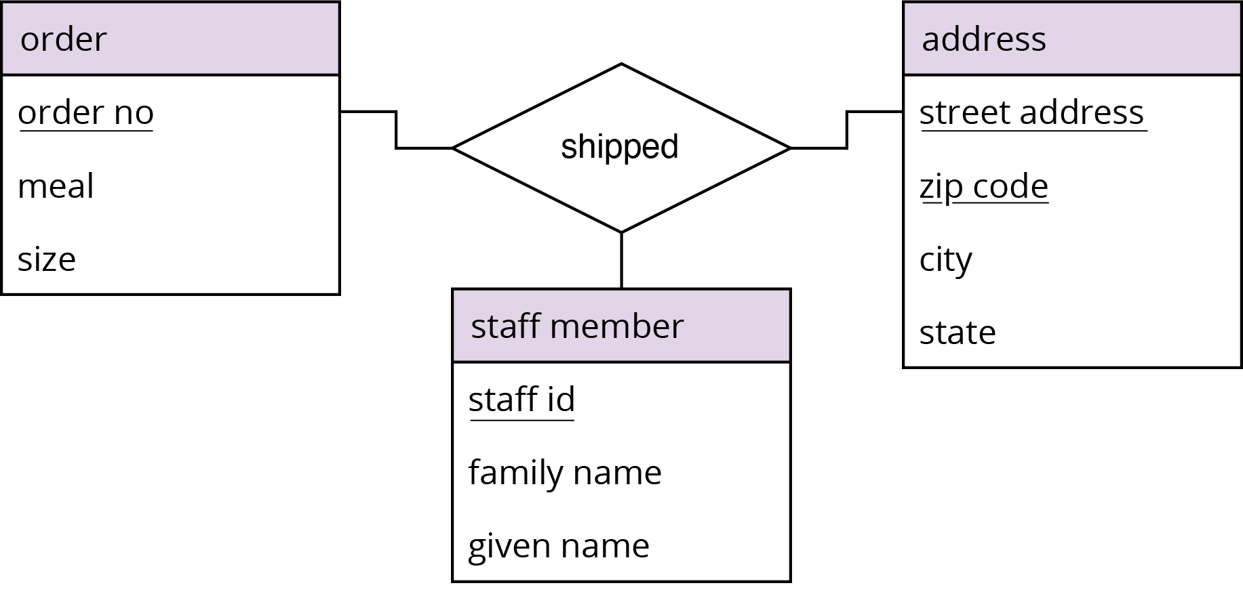
Entity relationship model #4
In addition to cardinality conditions, relationships may also have participatory conditions:
optional (e.g., 0..n) or mandatory (e.g., 1..n)
A relationship connecting three entities is called a ternary relationship

Slide 20
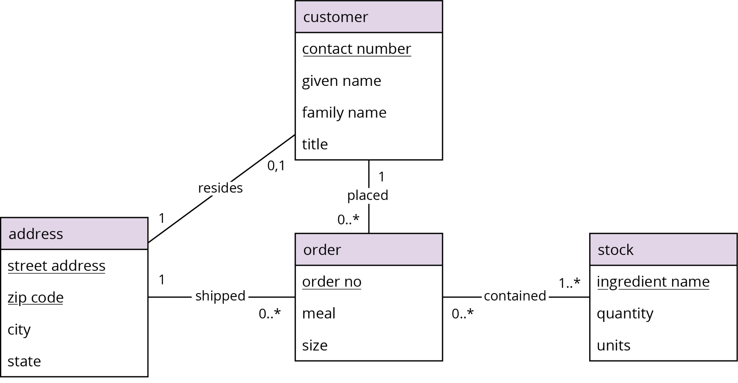
Example Nutty Nuggets E-R model

Slide 21
Section 2.3
Relational databases

Slide 22
The relational model
A relational database is a collection of relations, often just called tables
Each relation has has associated with it a set of attributes
The data in the relation is structured as a set of rows, often called tuples
Each tuple consists of data items for each attribute
Each cell in a tuple contains a single value
Relations have the following properties:
The ordering of tuples in the relation is not significant.
Tuples in a relation are all distinct from one another.
Columns are ordered so that data items correspond to the attribute in the relation scheme with which they are labeled.

Slide 23
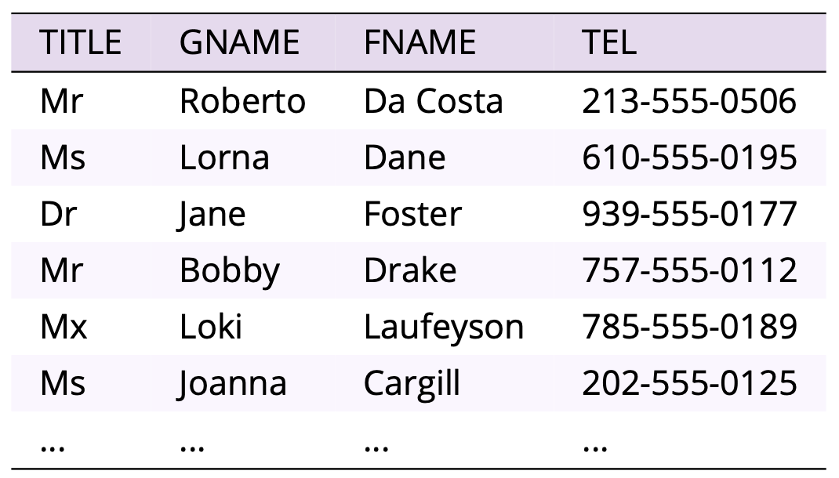
Example relation

Slide 24
Relation schemes #1
A relation scheme is a set of attribute names and a mapping from each attribute name to a domain (data type)
A database scheme is a set of relation schemes
A relational database is a set of relations.
A relational database management system (RDBMS) is the software that manages a relational database
In most relational systems, data items are atomic
A relation that contains only atomic items is said to be in first normal form (1NF)
The degree of a relation is its number of columns
The cardinality of a relation is the number of tuples

Slide 25
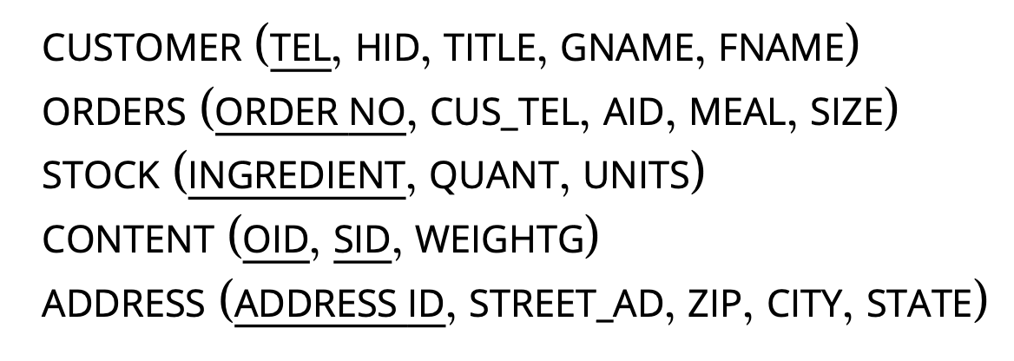
Relation schemes #2
A candidate key is an attribute or minimal set of attributes that will serve to uniquely identify each tuple of the relation.
There may be several such candidate keys for a relation. The identifier in an E-R model will usually be a potential candidate key.
One candidate key is chosen as the primary key.

Slide 26
Relational database design
An E-R model may be transformed into a set of relation schemes. As a first pass, the general principle is that to begin:
each entity in the E-R model maps to a relation in the relation scheme;
each attribute in the E-R model maps to an attribute in the corresponding relation;
each identifier maps to a primary key;
each relationship maps to a relation combining the identifiers/primary keys of the two entities/relations it connects.
In some cases it is also necessary to modify this first pass in order to maintain the information structure, while balancing the redundancy that accompanies too few relations and the inefficiency that arises from too many.

Slide 27
Operations on relations
There are five fundamental relational operators: union, difference, product, project, and restrict
Three derived relational operators are also important: intersection, divide, and join
Together, these operations and the way they are combined is called relational algebra
The relational model is said to be closed, because relational operators take one or more relations as input and return a relation

Slide 28
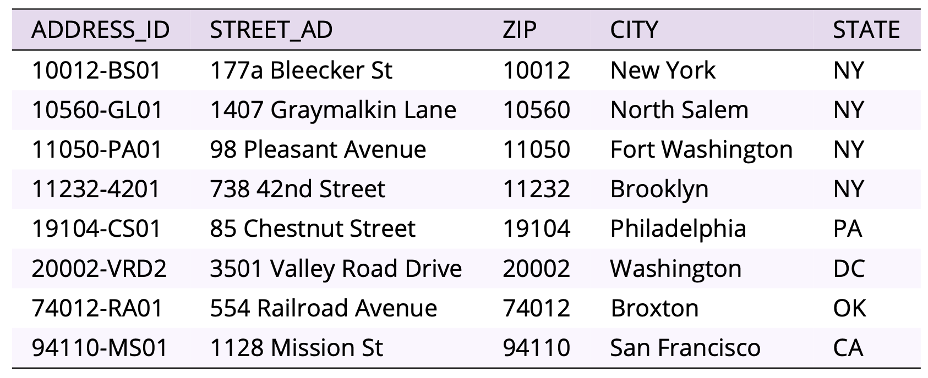
ADDRESS relation

Slide 29
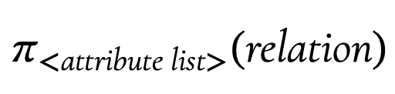
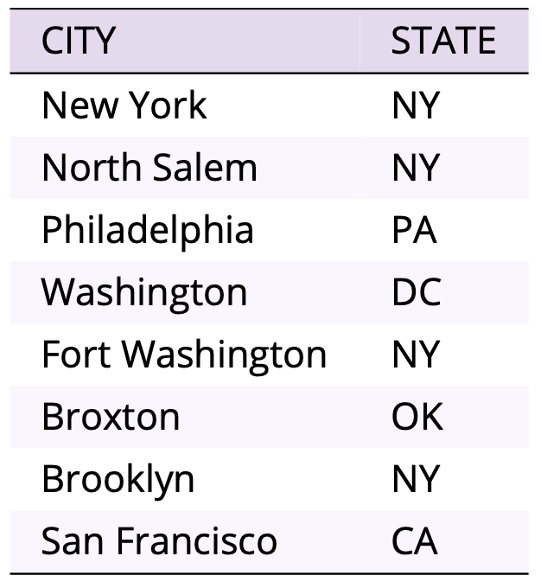

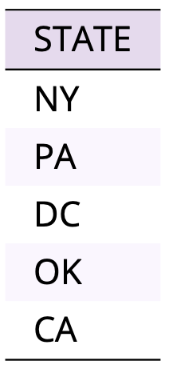
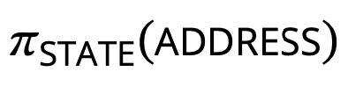
Project operator
The project operator is unary
It outputs a new relation that has a subset of attributes
Identical tuples in the output relation are coalesced

Slide 30
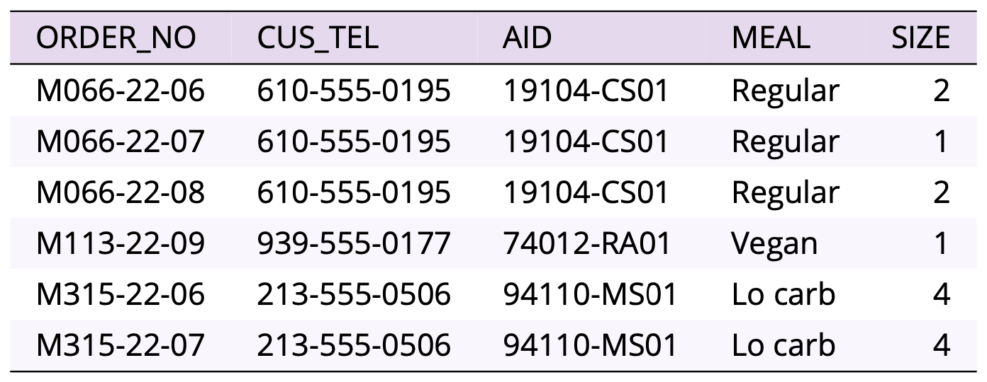
ORDERS relation

Slide 31
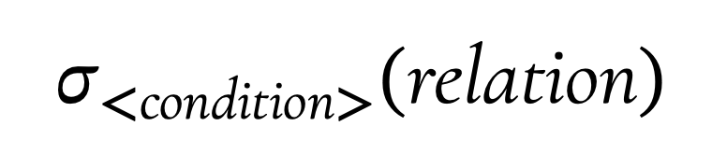
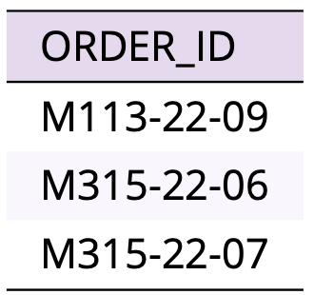
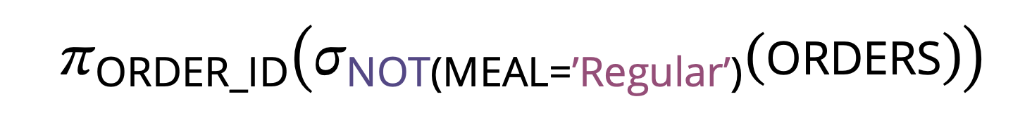

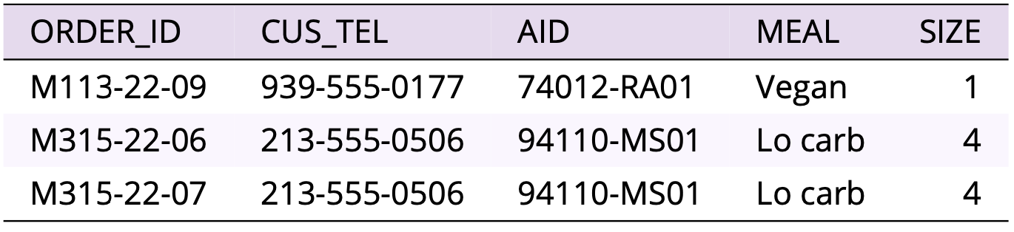
Restrict operator
The restrict operator is unary
It outputs a new relation that has a subset of tuples
A condition specifies those tuples that are required

Slide 32
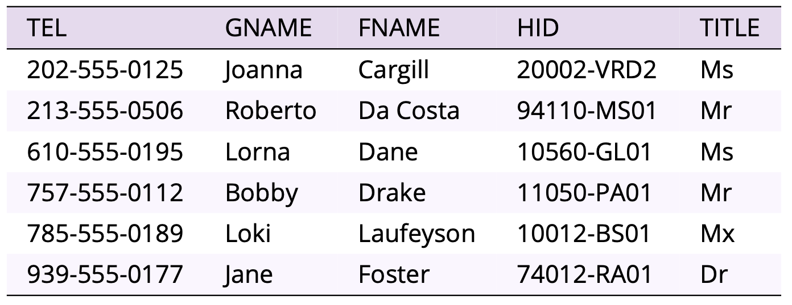
CUSTOMER relation

Slide 33
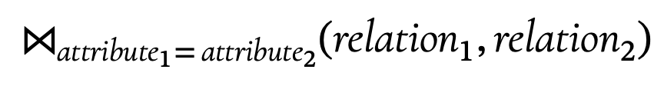

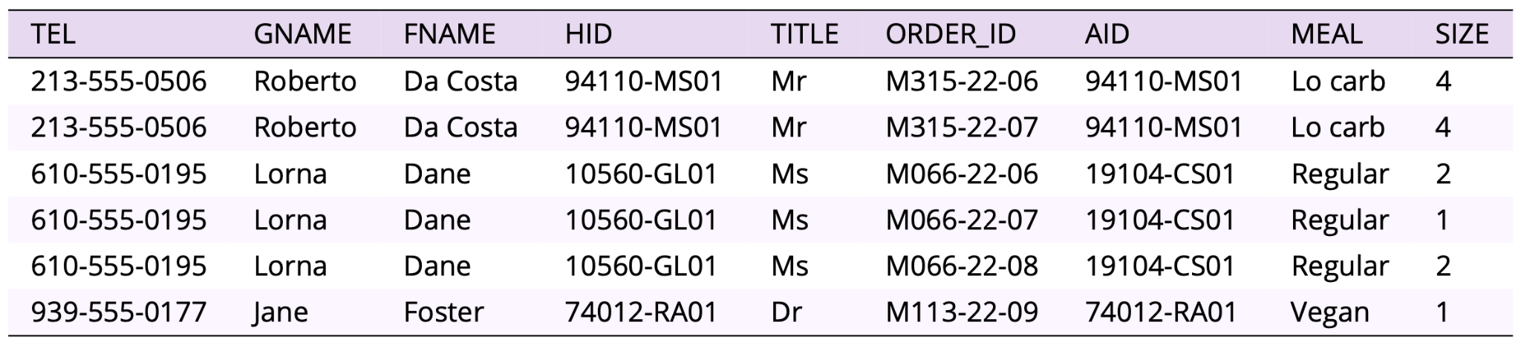
Join operator
The join operator is binary
It outputs the combined relation where tuples agree on a specified attribute (natural join)
Join is the most time-consuming of all relational operators to compute

Slide 34
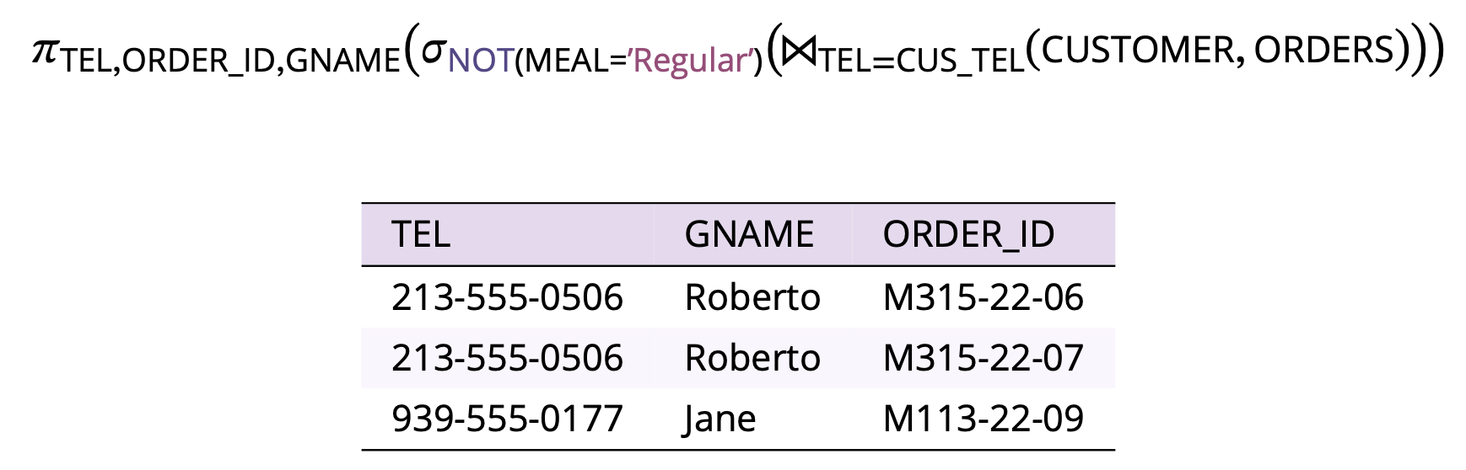
Combining operators
In general, relational operators may not be arbitrarily reordered
Query optimization aims to find an efficient way of processing queries, for example reordering to produce equivalent but more efficient queries

Slide 35
Section 2.4
Graph databases

Slide 36
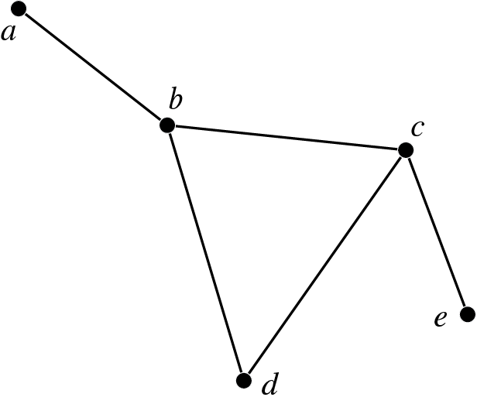
Abstract graphs #1
A graph is a highly abstracted model of connectivity between elements.
A graph is made up of a set of distinct nodes together with a set of edges that connect pairs of nodes.
A node is said to be adjacent to another node if both nodes are connected by an edge.
An edge is said to join or to be incident on the nodes it connects.
Likewise, a node is said to be incident with an edge that connects to it.

Slide 37
Abstract graphs #2
The order of a graph is the number of nodes it contains.
The degree of a node is the number of edges with which it is incident.
A path through a graph is a sequence of nodes in the graph where each consecutive pair of nodes is adjacent.
A connected graph is one such that there exists a path between any two of its nodes.
A path from a node to itself traversing at least one edge is called a cycle.
A graph that has no cycles is called an acyclic graph.

Slide 38
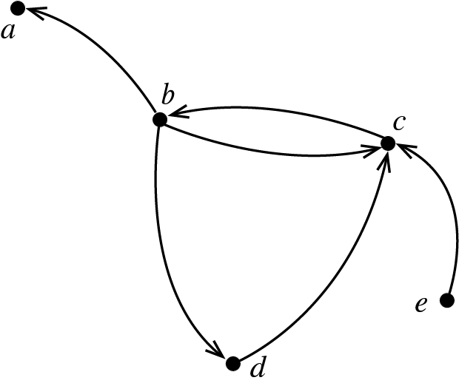
Abstract graphs #3
Graphs may be undirected, meaning that the direction of the edges is not significant.
A directed graph or digraph is a graph in which each edge is assigned a direction.
In a directed graph an edge from 𝑎 to 𝑏, written 𝑎𝑏, is distinct from an edge from 𝑏 to 𝑎, written 𝑏𝑎.
In diagrams, directed edges are usually indicated by arrowed lines.

Slide 39
Abstract graphs #4
A labeled graph is a graph in which each edge and/or node is assigned a label (maybe a number or string).
A weighted graph is a labeled graph in which each label is a (usually non-negative) number, or weight.
A multigraph is a graph that supports multiple distinct edges between a pair of nodes, whereas ordinarily there can be at most one edge between any pair or nodes.
A hypergraph is a graph where a single edge may connect more than two nodes, whereas ordinarily an edge connects exactly two nodes.

Slide 40
The graph database model
The most common graph databases are founded on three basic structures:
Nodes are used to represent entities in a domain. Nodes are approximately equivalent to a record or a tuple in a relational database.
Edges are used to represent relationships between entities. Edges are central to the difference between graph and relational databases. The relational model contains no comparable structure.
Properties are data associated with nodes or edges. Properties are akin to attribute values in relational databases.

Slide 41
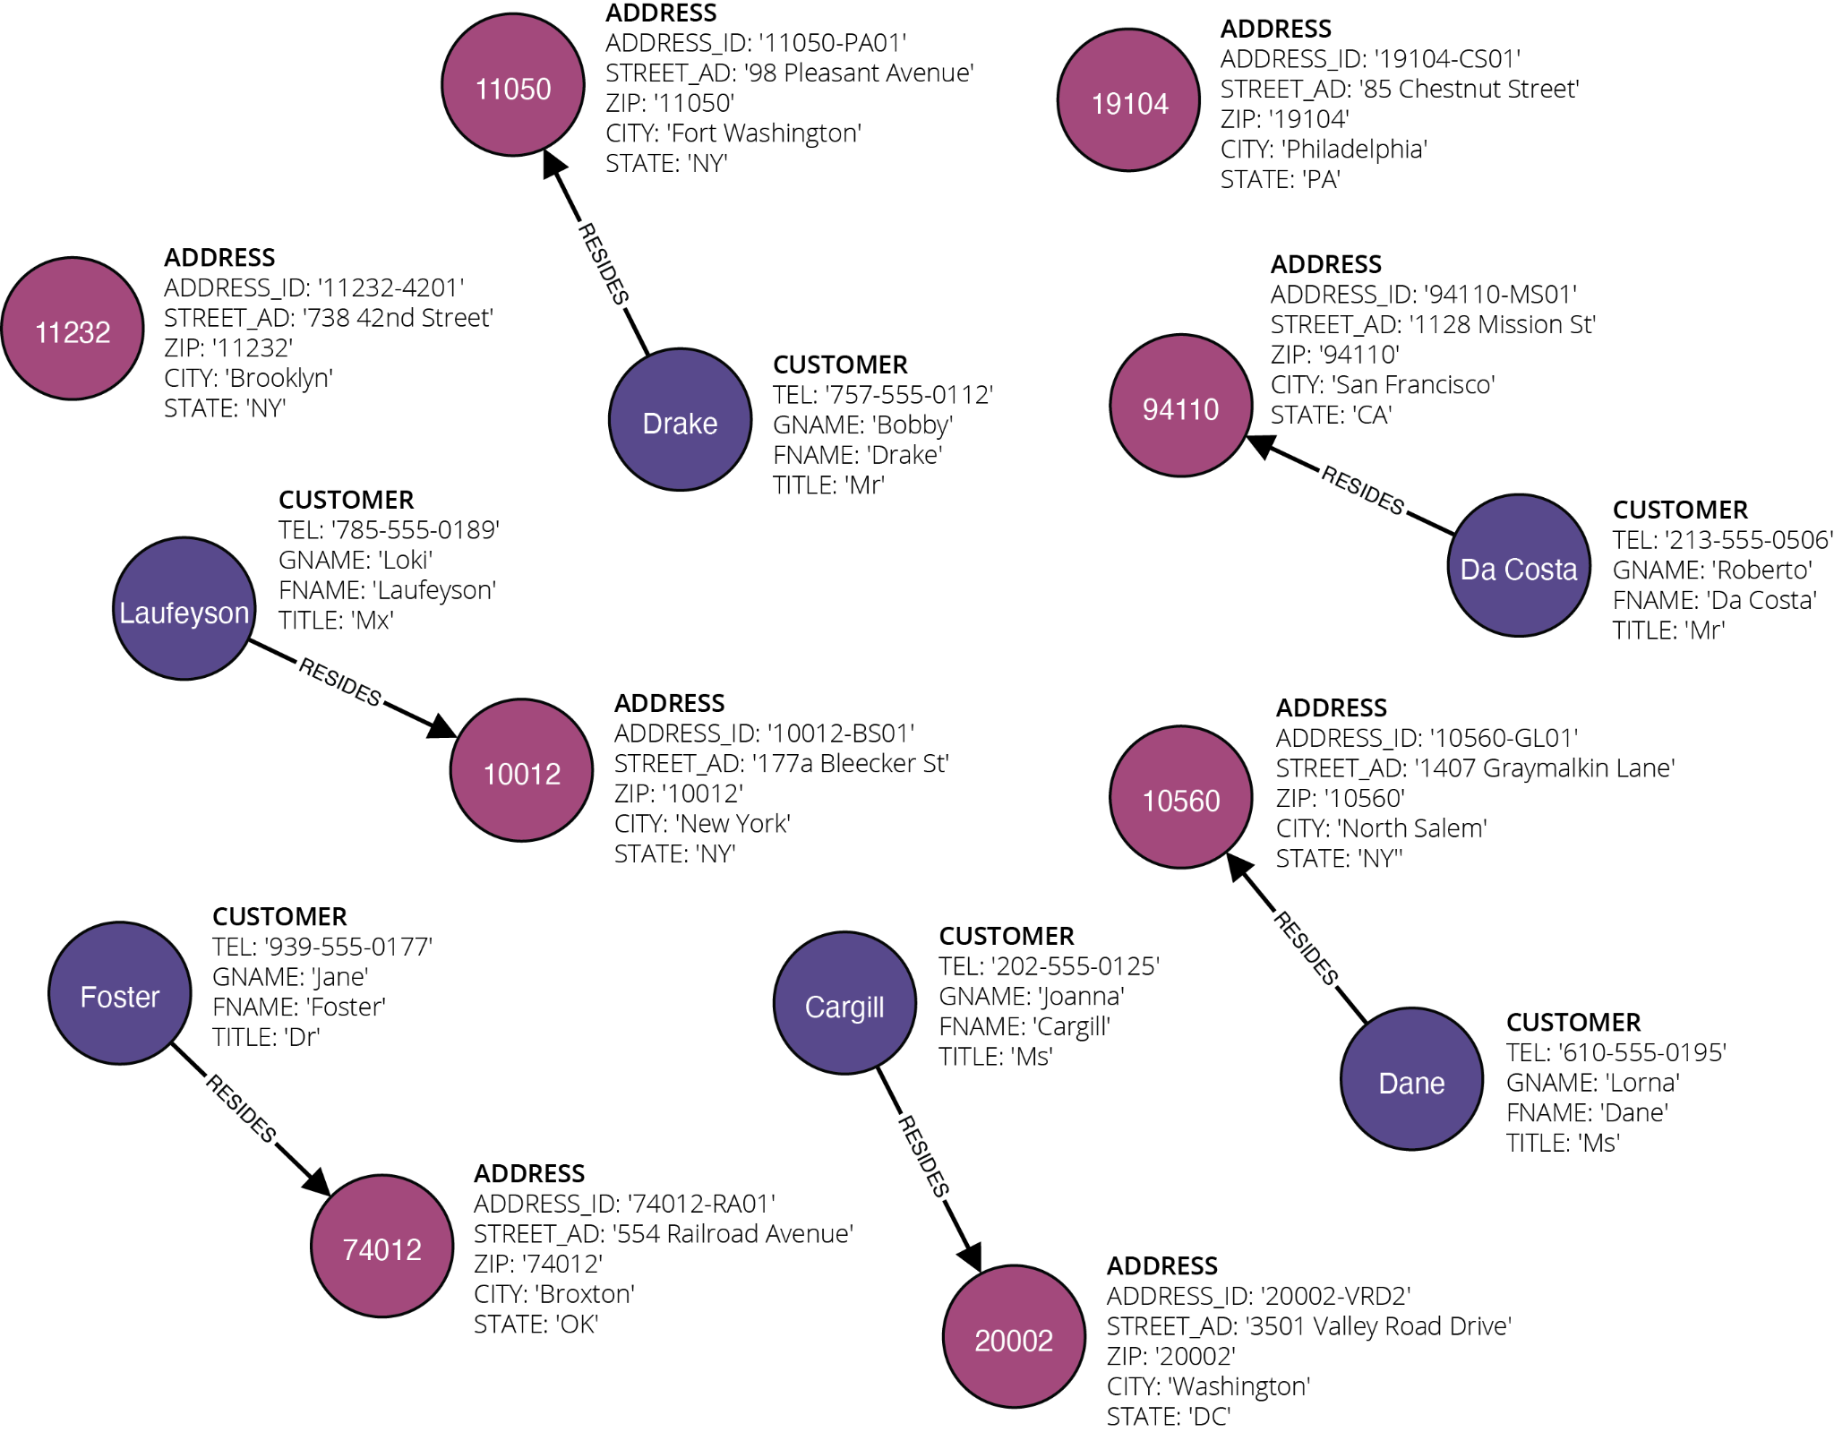
Example graph database

Slide 42
Graph database design
The first step in designing a graph database is, again, designing the E-R model
The next step is to again translate that model into a database scheme
Some natural mappings immediately suggest themselves as a first pass, namely:
each entity in the E-R model maps to a set of nodes in the graph database;
each attribute in the E-R model maps a property found on each corresponding node;
each relationship maps to a set of edges connecting corresponding nodes.
Unlike a relational database, a graph database does not usually require primary keys to be identified from the conceptual model.

Slide 43
Acknowledgments
Book website: http://gisacp.duckham.org All images: GIS: A Computing Perspective 3e, unless otherwise stated
Artwork: Lou Bloomer

